Slide 1
Intro – Programming in R and Python
Jan van Grimbergen, Jonathan Bobak
18.11.2024

Slide 2
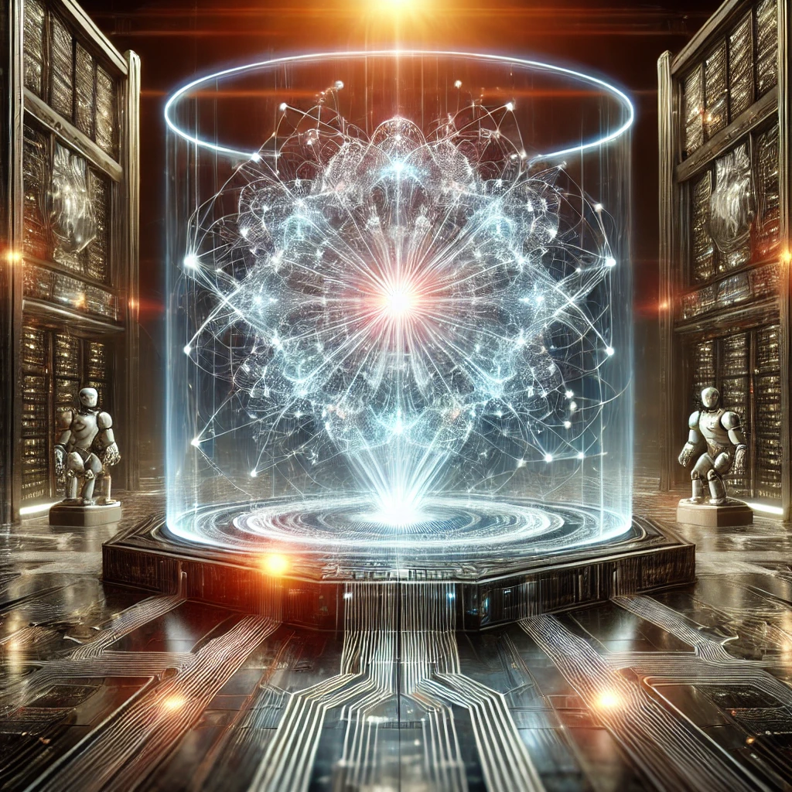

Computers are inherently dumb
Expectation
Reality

Slide 3

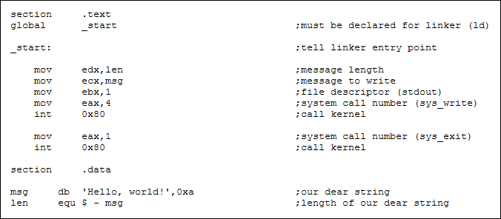
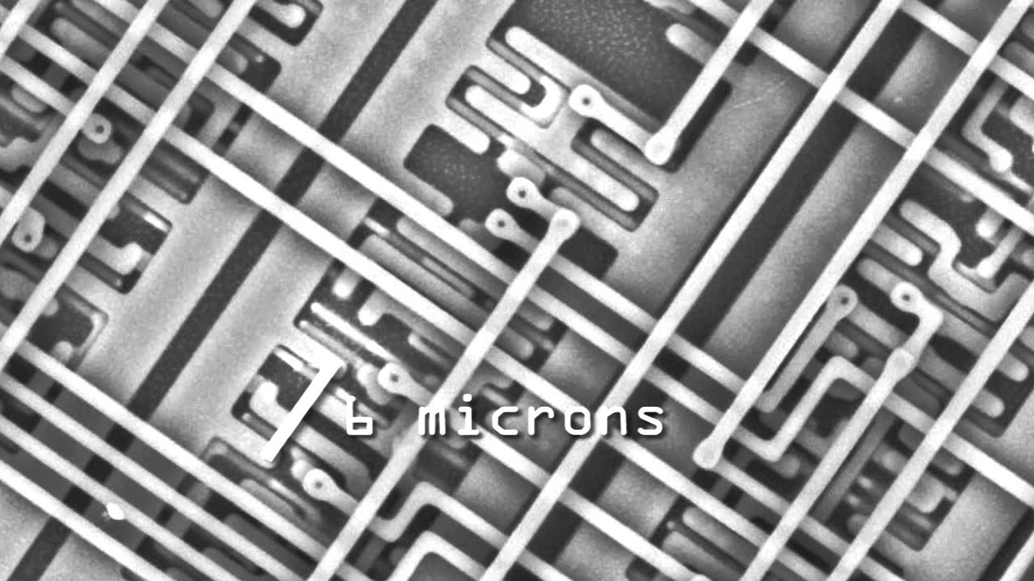


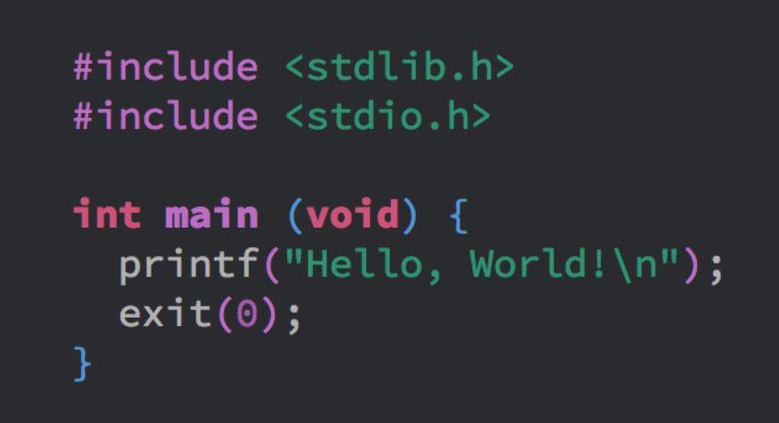
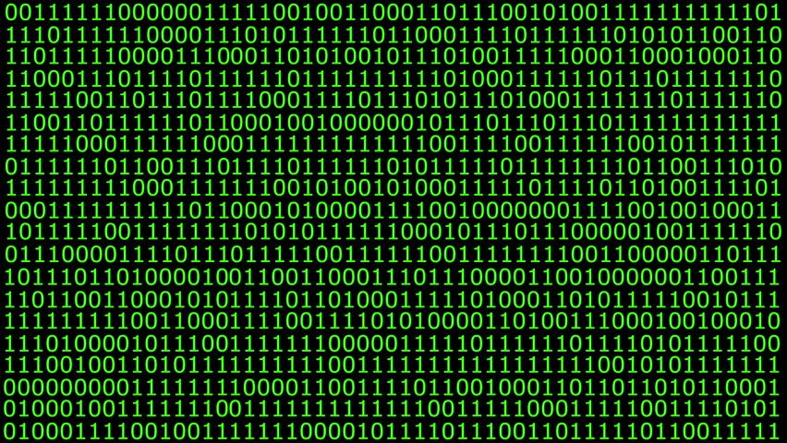

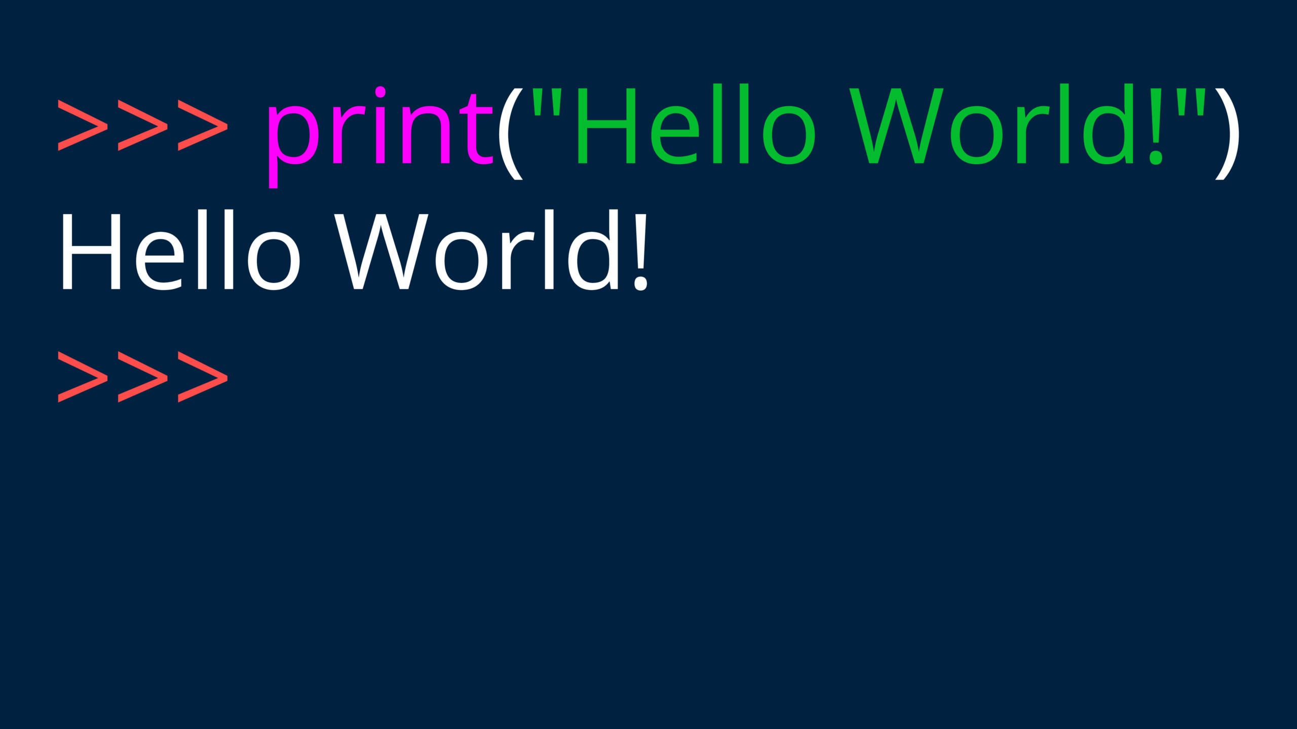

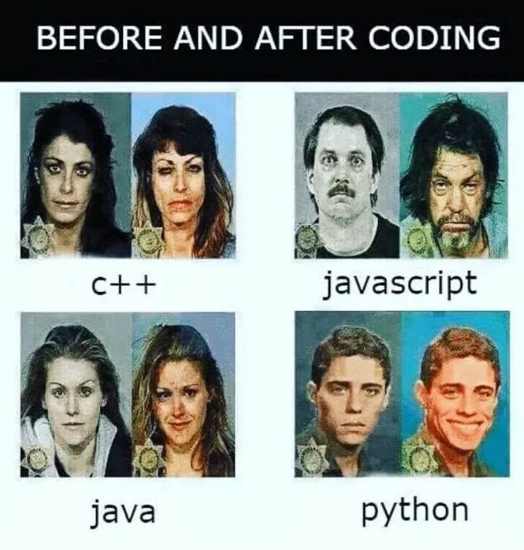
From language to 0s and 1s
Machine
language
Human
language
Suffering
Enjoyment

Slide 4
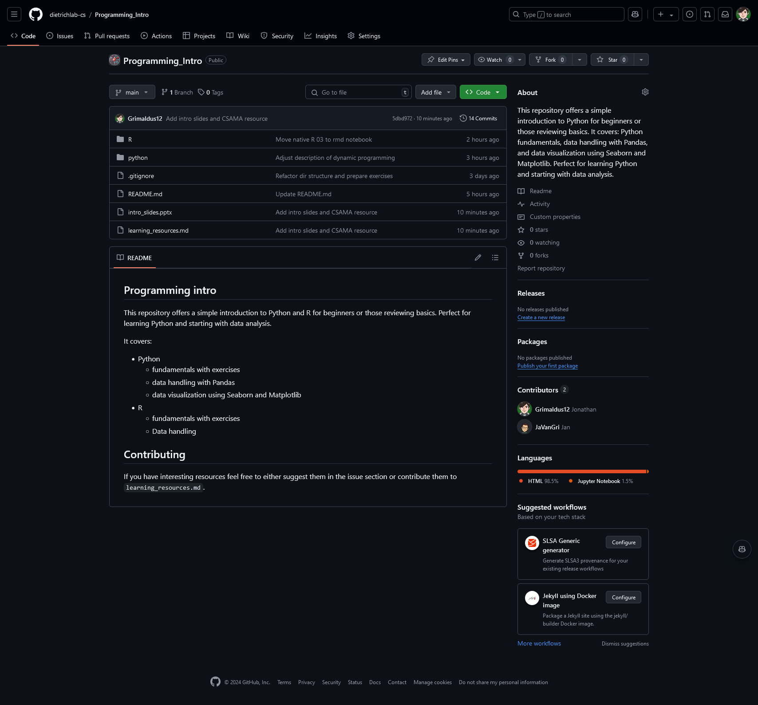
GitHub Repo
All notebooks and exercises from today
R and python
including datasets
learning_ressources.md
tutorials, cheat sheets and tools for programming
for both R and python
If you find a resource online helpful
contribute and share it here
(GitHub Account required)

